Slide 1
UWC 2.0 IMPLEMENTATION

Slide 2
TABLE OF CONTENTS
01
03
02
INTRODUCTION
IMPLEMENTATION
REQUIREMENTS FOR THE WEB
04
RISK AND CONSTRAINTS

Slide 3
INTRODUCTION
UWC 2.0 is an website developed creating an environment where users are able to create tasks, routes and view information(Back officers), view tasks and information of MCPs and vehicles(Collectors and janitors) visually for collecting urban waste. Not only that, users could interact which each others through chat system and also for timekeeping.

Slide 4
REQUIREMENTS FOR THE APPLICATION

Slide 5
REQUIREMENTS FOR THE WEB
Login
Change personal information of account
Create Tasks
View information of employee
Create routes
View information of MCPs and vehicles

Slide 6
IMPLEMENTATION

Slide 7
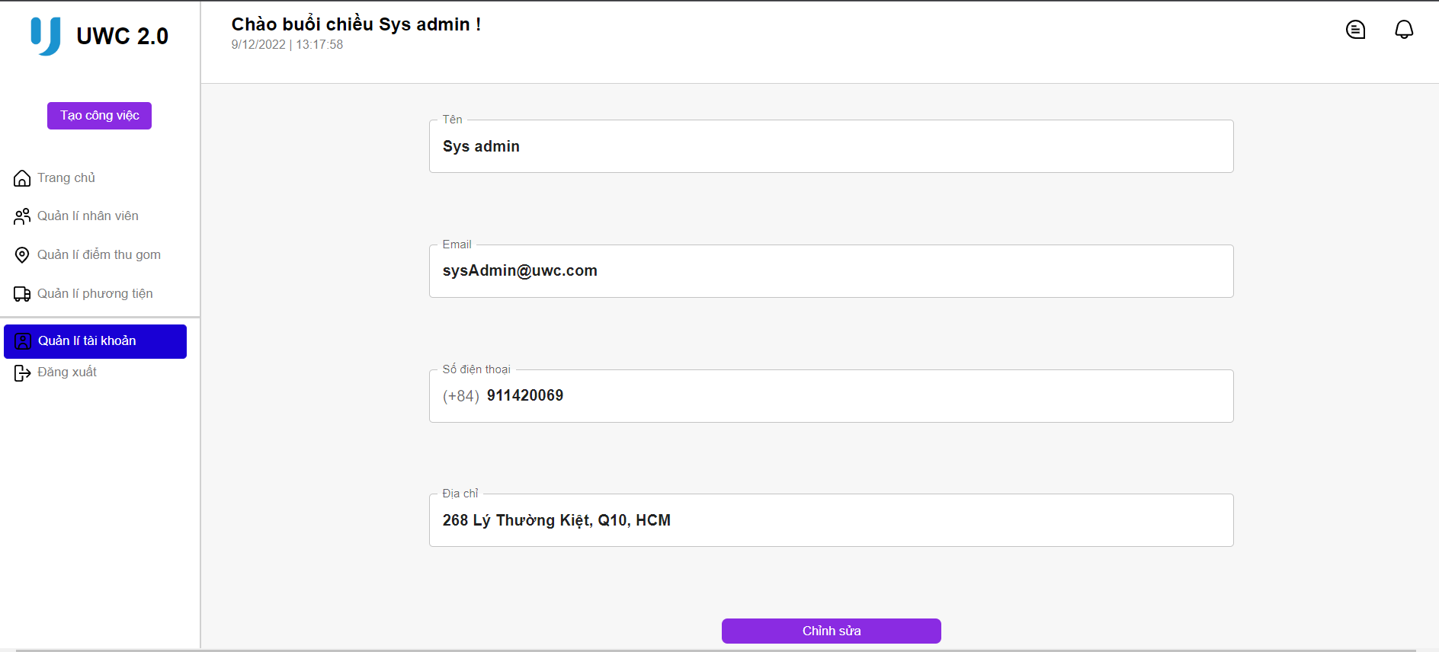
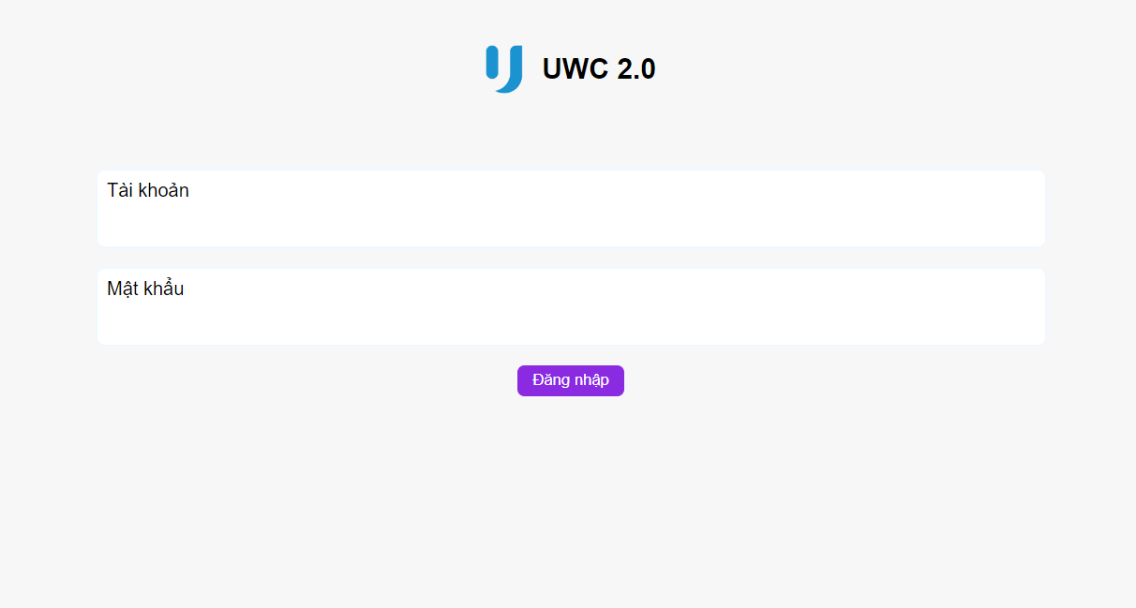
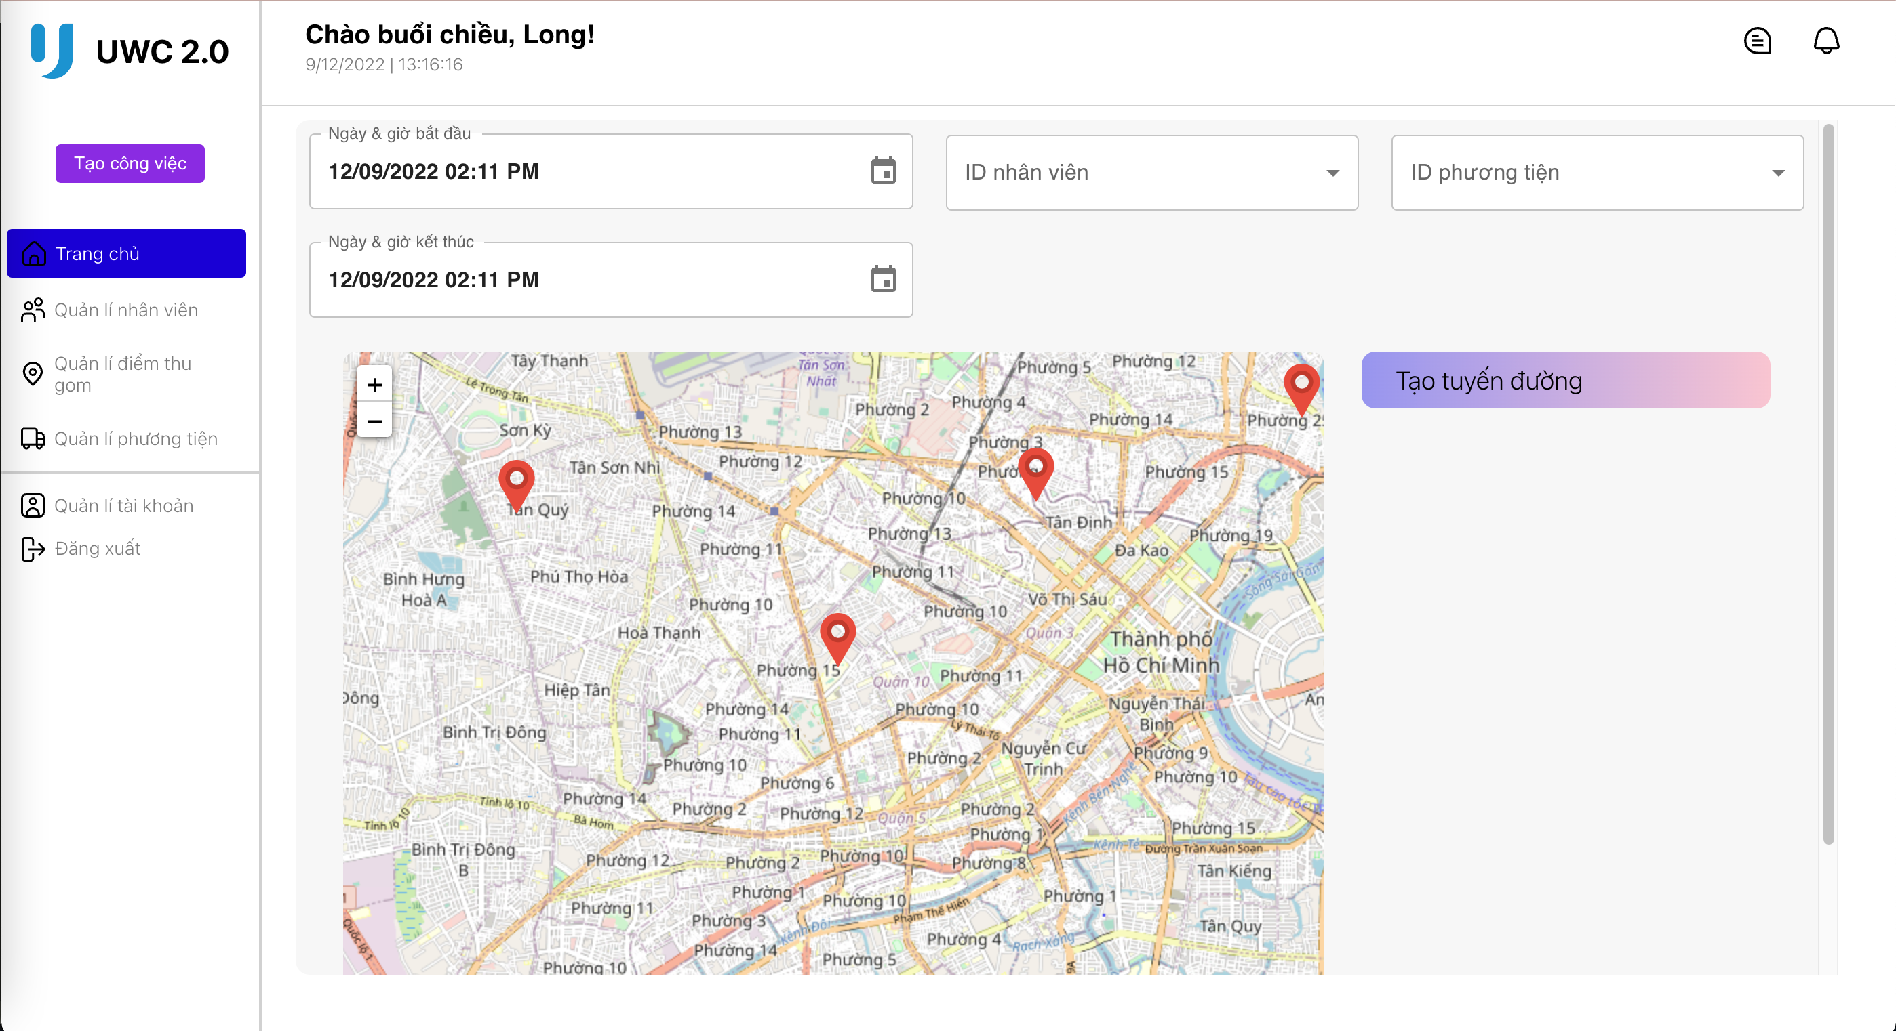
IMPLEMENTATION
Login
Create tasks
Change personal information of account

Slide 8
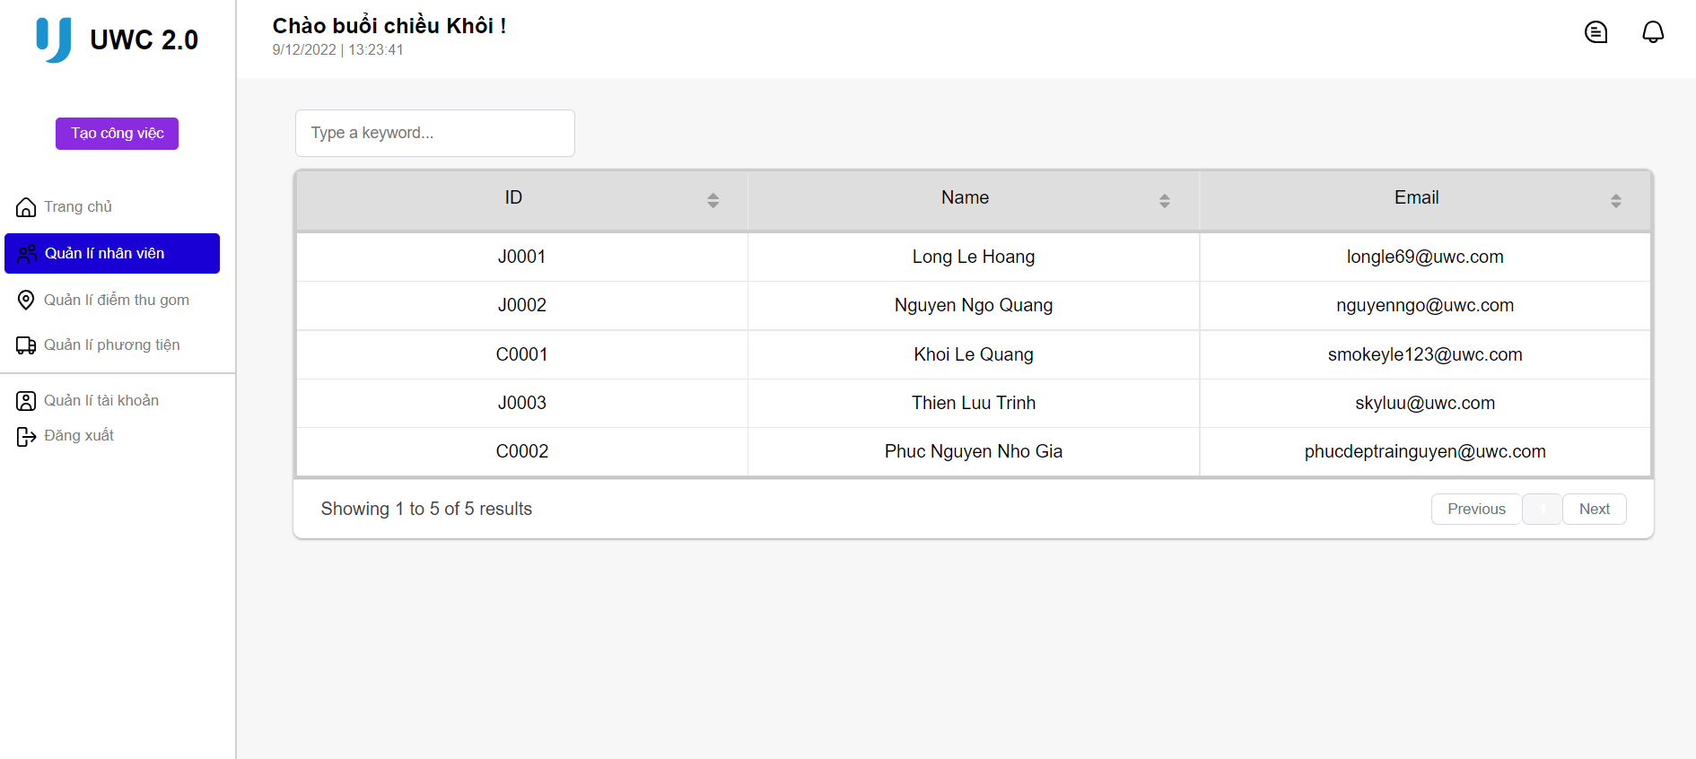
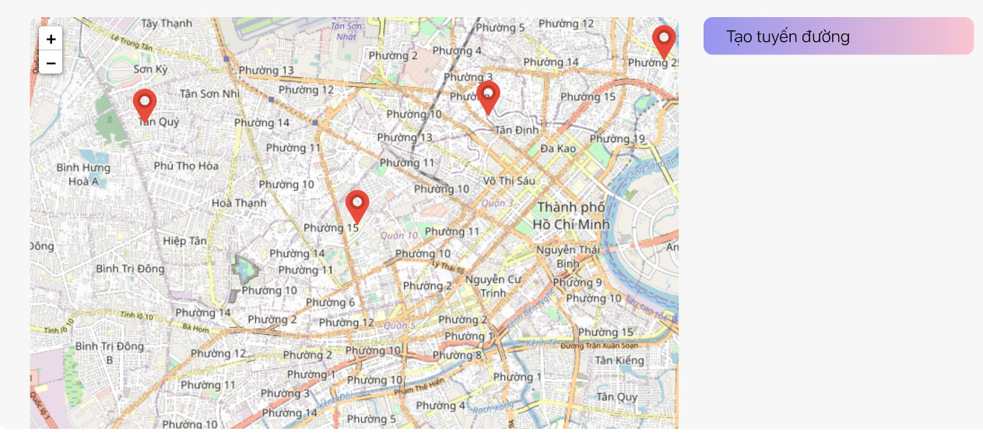
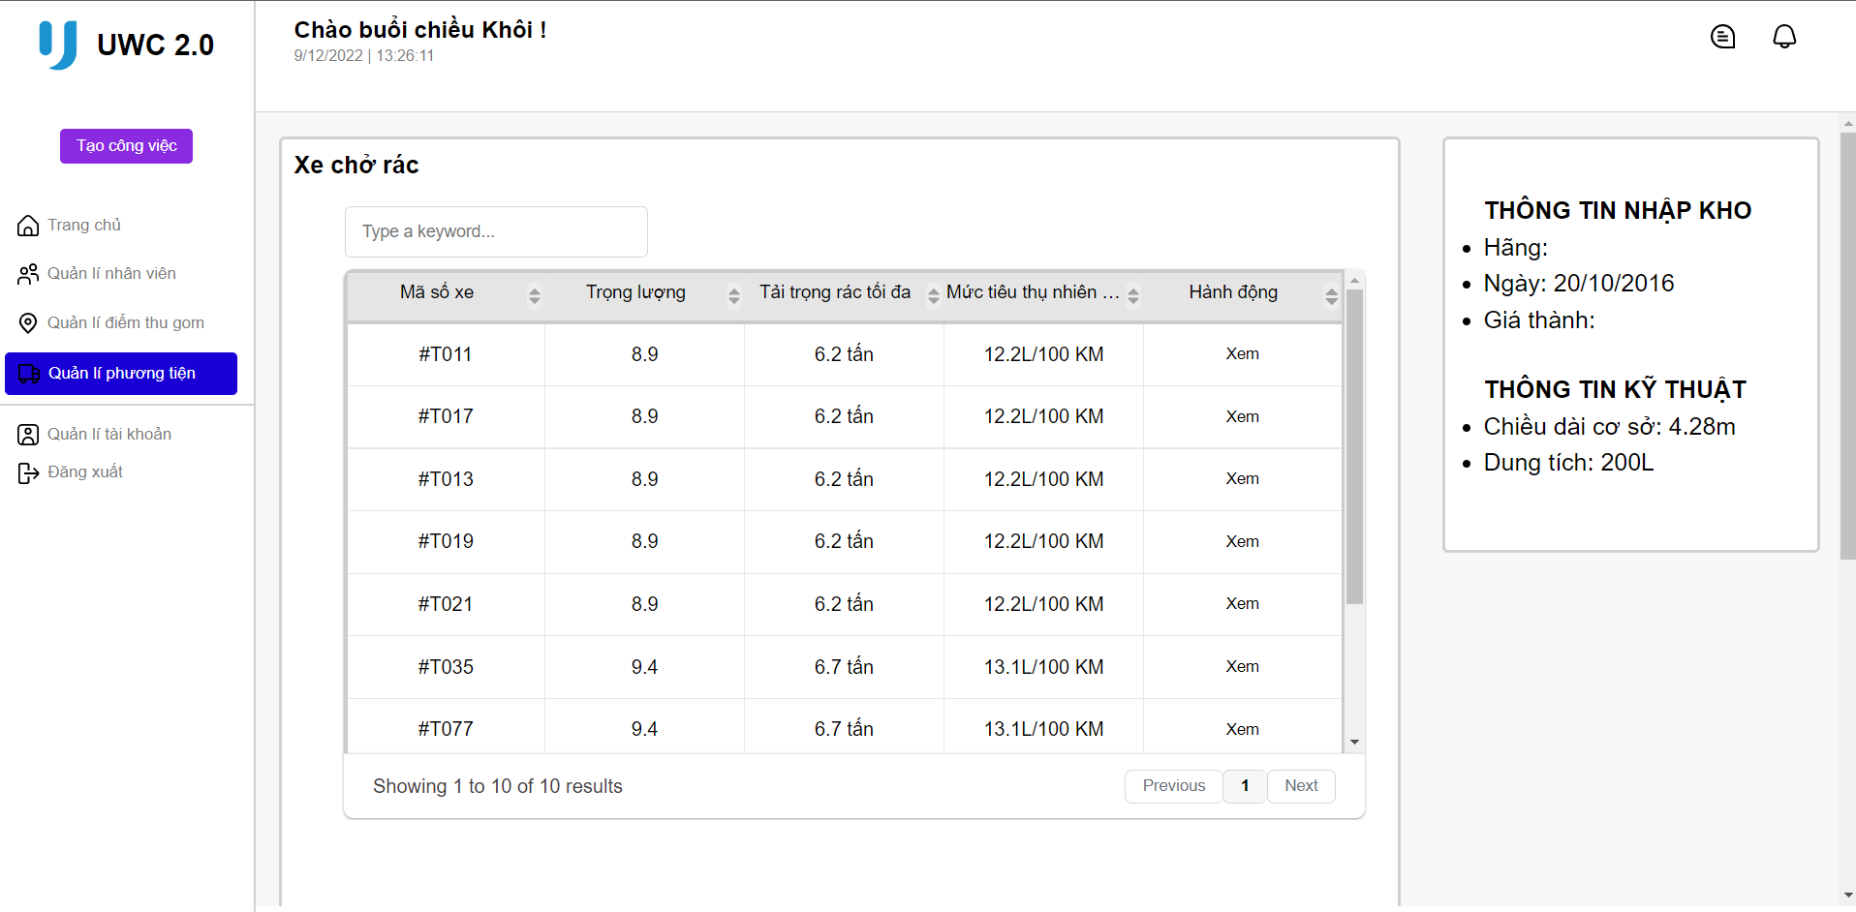
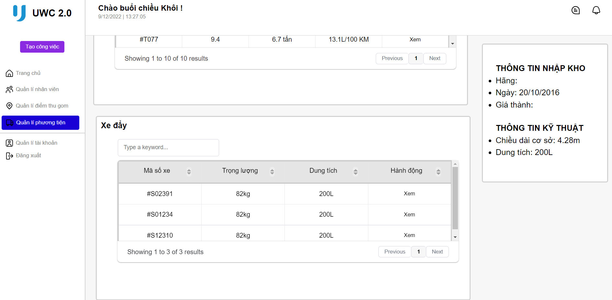
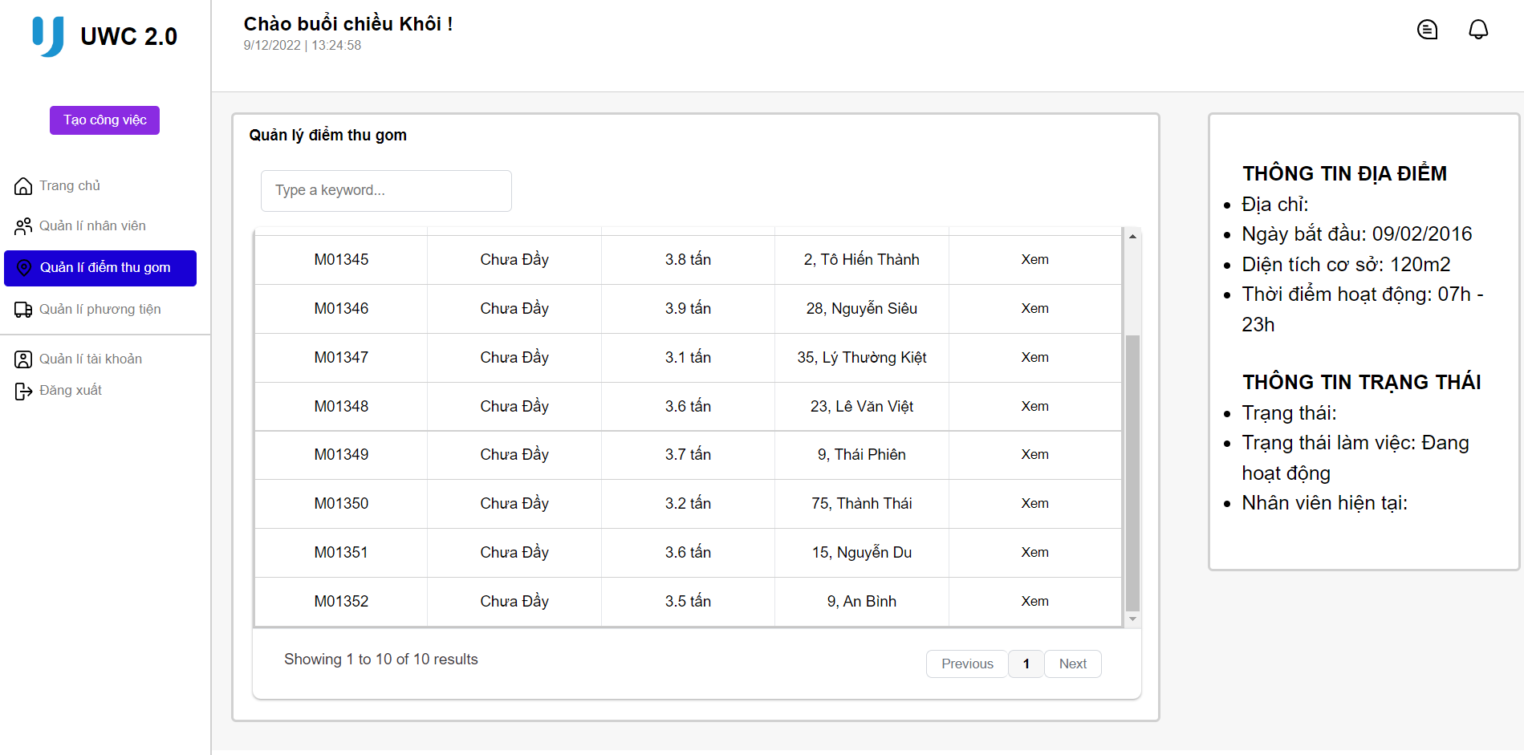
IMPLEMENTATION
View information of employee
View information of MCPs and vehicles
Create routes

Slide 9
RISK AND CONSTRAINTS

Slide 10
Risks
No security measure.
Display may vary or break on different screen widths.
Possible wrong system assumptions.
Haven't been tested on large database, may affects responsiveness, speed, display sizes.

Slide 11
Constraints
The UI is not fully responsive yet.
The task creation page currently doesn’t fully match the Figma design.
Some design features, assumptions may not match customer expectations.

Slide 12
THANKS!

